Slide 1

Fundamentals of Politics Research Lecture 3 (2020-21) Answers
Dr Adrian Blau

Slide 2
Last time
All descriptions and explanations are inferences.
There’s more to social science than description and explanation. Norms matter!
Learning how to ask the right questions is incredibly important. Creativity is crucial!
This helps you to be constructively critical and write better essays.

Slide 3
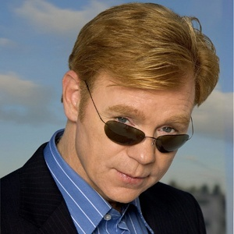
Thinking like a detective

Slide 4
This week
especially in political theory
Deduction
Induction.
Abduction.
How to do them well.
How they can go wrong, and how you can spot and criticise this.
Baggini and Fosl, on KEATS.
Fundamentals.
especially in empirical work
in both – not just empirical
Topics 4-5 & your statistics modules also tackle this.

Slide 5
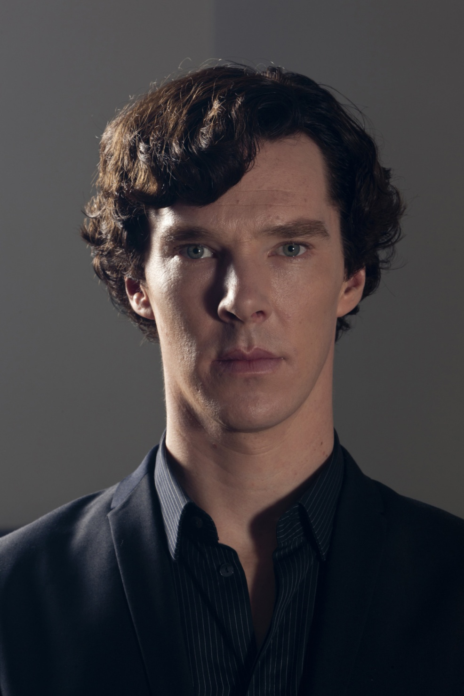
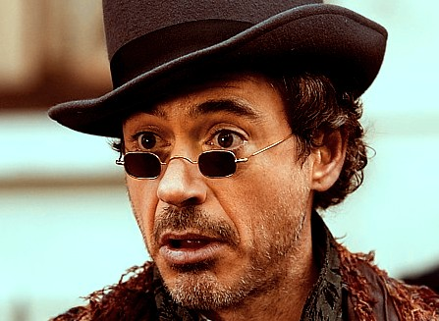
Deduction

Slide 6
Deduction
Conclusion follows necessarily from premises.
All men are mortal.
Socrates is a man.
Socrates is mortal.
All fish are carrots.
Socrates is a fish.
Socrates is a carrot.
Brazil have won more men’s World Cups than Argentina.
Brazil have won more men’s World Cups than England.
Argentina have won more men’s World Cups than England.
‘Conditional’ (if–then).
Question the ‘ifs’ and the ‘then’.
‘The politician’s syllogism’:
We must do something.
This is something.
We must do this.
Valid (logical) + true (empirical) = sound.

Slide 7
Deduction in political theory
Cohen (2011, 147): if you are forced to do something, you are free to do it.
‘Australians are free to vote, even though they are not free not to vote, since voting is mandatory in Australia. One could say that Australians are forced to vote, but that proves that they are free to vote, as follows: one cannot be forced to do what one cannot do, and one cannot do what one is not free to do. Hence one is free to do what one is forced to do.’

Slide 8
Deduction in political economy and political science
Especially in game theory, rational choice theory, formal modelling in economics, etc.
E.g. show that X must happen if certain assumptions are correct. But the real test (seeing if X happens) is not itself about deduction, and even if X happens, it may not be because the deductive model is right.

Slide 9
Positive or negative?
Habermas (1984, 24): deductive arguments ‘do not bring anything new to light’.
Not always true (e.g. Cohen, formal modelling etc.).
Negatively important: many attempted deductions are invalid, or are misleadingly presented as if they deductive.

Slide 10
Informal fallacies
Learn the informal fallacies and cognitive biases (seminar).
Next week’s seminar also examines Kendra Dupuy and Siri Neset, ‘The cognitive psychology of corruption’ (2018).

Slide 11
Induction
Extrapolation.
The sun has always risen in the east, therefore ….
3,638,822 and 39,916,824
Y = (X −1)(X −2) … (X −10) + 2X
1 | 2 | 3 | 4 | 5 | 6 | 7 | 8 | 9 | 10 | 11 | 12
2 | 4 | 6 | 8 | 10 | 12 | 14 | 16 | 18 | 20 | ? | ?

Slide 12
Under-determination
(Also known as indeterminacy.)
There are always least two different explanations of the same evidence.

Slide 13
Omitted variable bias
‘Confounding’ variables which aren’t included in the analysis but actually affect the outcome.
E.g. my teeth.
Jargowsky (2005): we should use ‘theory, prior empirical research, and common sense as a guide to what variables ought to be included in the model. Given the near impossibility of measuring all the relevant variables, virtually all social science analyses are plagued by omitted variable bias to one degree or another.’
KKV (1994, pp. 176-82).

Slide 14
Exercise 1
Apply the problem of induction, under-determination and omitted variable bias to the following statement:
‘In 20 out of 24 countries tested, corruption is inversely related to the degree of democracy. This means that corruption undermines democracy. Policy-makers who want more democracy must thus reduce corruption.’

Slide 15
Uncertainty
We can never know for certain if any empirical claim is true.
KKV: uncertainty is one of the four core features of science (1994, 8-9).
We should therefore (a) reduce and (b) report the degree of uncertainty in empirical work.
In history of political thought, and qualitative work in general, see Blau (2011, especially 362-8).
Proof is a dirty word.

Slide 16

Proof?
Google ‘science proof’:
Scientific proof of the Bible.
Scientific proof of reincarnation.
Scientific proof of the existence of God.
Mathematicians and philosophers talk of proof, natural and social scientists usually don’t.
Deductions can be proved, inductions can’t.
Descriptive & explanatory inferences are inductions.

Slide 17
Disproof? Falsification
Popper on falsification: you can’t prove a hypothesis but you can disprove it.
Quine/Duhem: no. The ‘disproof’ might not be a disproof – we could ‘explain it away’ (see topic 4 on theory-ladenness).
There is neither proof nor disproof in empirical research.

Slide 18
Scepticism
Kellstedt and Whitten section 1.2: ‘A core part of the scientific process is skepticism. … [A]s confident as we are in a particular theory, we remain open to the possibility that there is still a test out there that … makes us lose confidence in that theory.’
Elster (2007, 20): ‘One has consistently to think against oneself – to make matters as difficult for oneself as one can. We should select the strongest and most plausible alternative rival explanations, rather than accounts that can easily be refuted.’
The price of science is eternal scepticism.

Slide 19
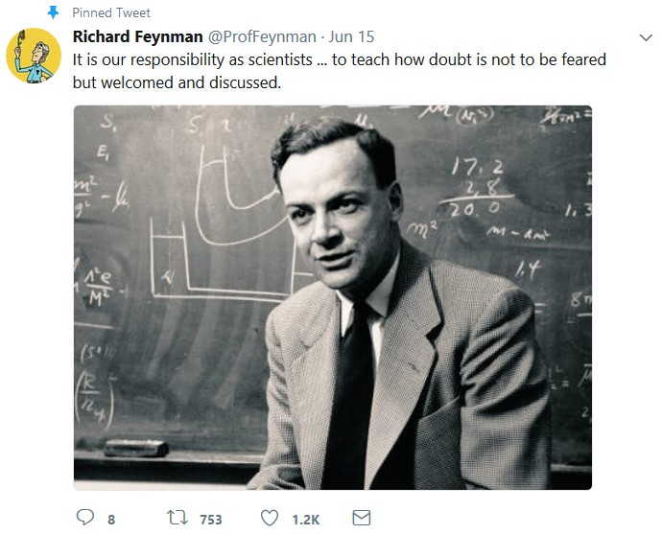

Slide 20
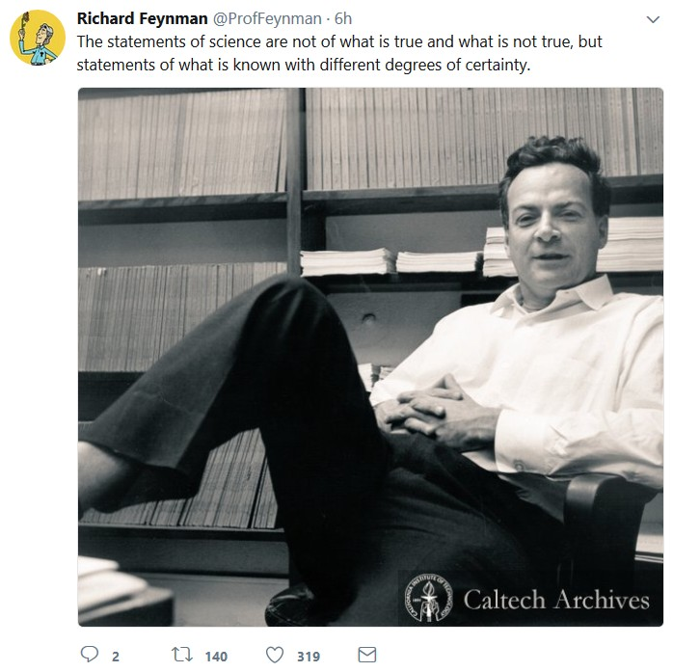

Slide 21
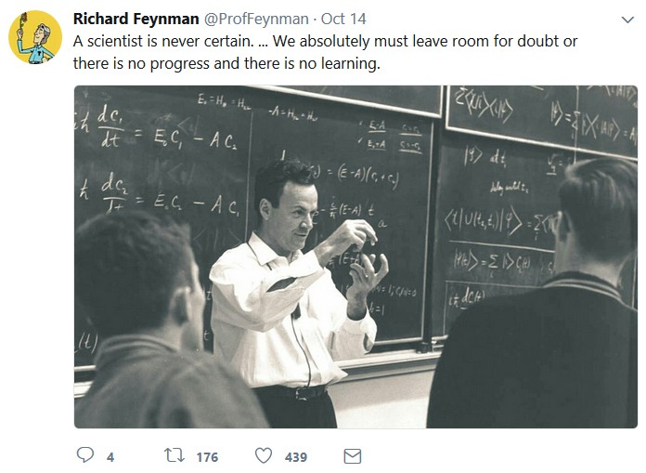

Slide 22
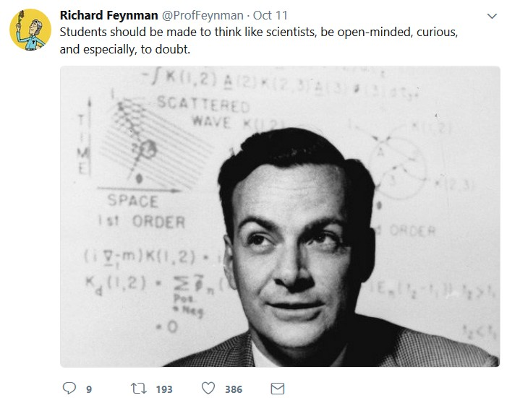

Slide 23
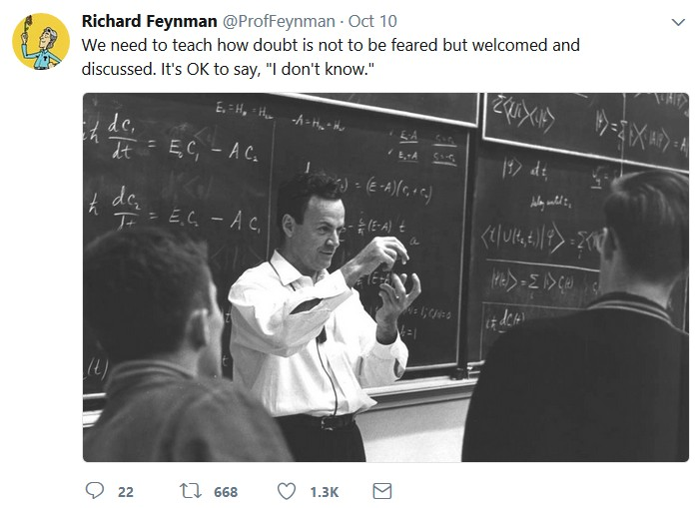

Slide 24
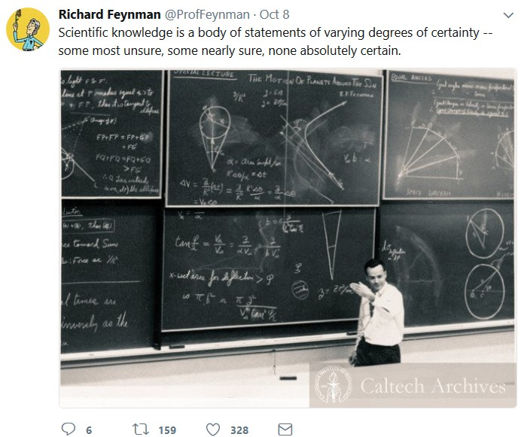

Slide 25
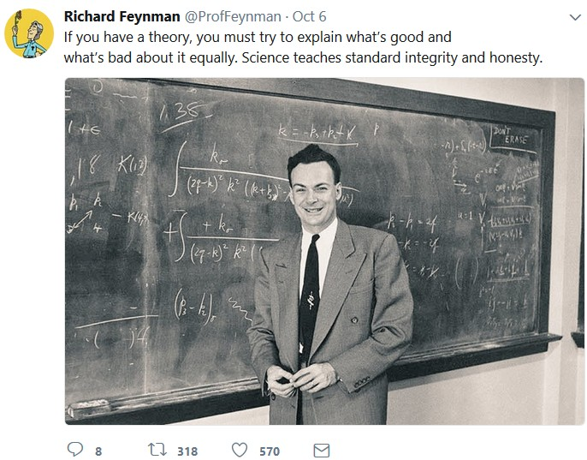

Slide 26
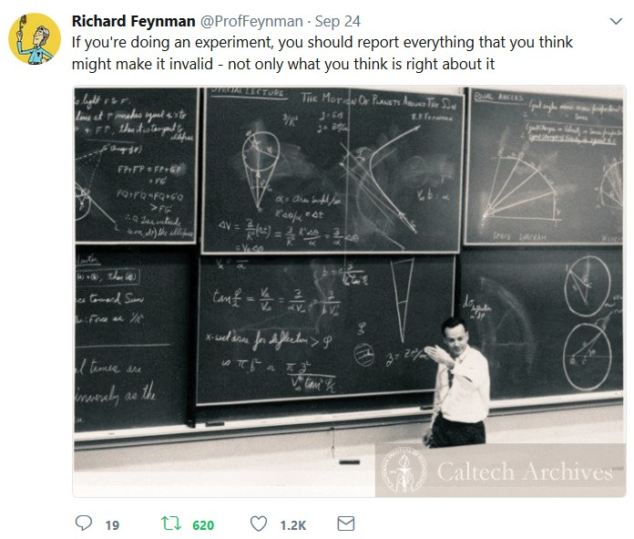

Slide 27
Exercise 2
Apply the ideas of uncertainty, falsification and scepticism to the following statement:
‘In 20 out of 24 countries tested, corruption is inversely related to the degree of democracy. This means that corruption undermines democracy. Policy-makers who want more democracy must thus reduce corruption.’

Slide 28
Mindset: key questions
Do I trust the data? Do I trust these intuitions?
How can I test these claims, e.g. objections, counter-examples, or other interpretations?
Am I or these authors trapped by theories?
How confident am I in these findings? How firmly should I present my conclusions? How generalisable are these claims?
Are we even asking all the right questions in the first place?
Negativity.
A disposition of falsification.

Slide 29
Internal vs. external validity
Internal validity: how well an empirical claim is established.
External validity: how generalisable the findings are.
Tradeoff? Limit the scope of generalisations?
But multiple studies can bring us closer to the best of both worlds.

Slide 30
Summary of inductive problems
The best social scientists know that:
underdetermination, uncertainty and omitted variable bias are unavoidable;
proof and disproof are impossible.
But no social scientist is perfect, and most are rather less than perfect!
You can always:
criticise what you read using the above ideas;
improve your essays with (constructive) criticism.

Slide 31
Abduction
Abduction/inference to the best explanation.
Blau:
abduction: coming up with different possible interpretations.
IBE: choosing the interpretation you think is best.
KKV pp. 32-3. Question the data too.
Interpretation is relative.
N.B. We often don’t have the space to abduce (or test our abductions) as well as we should.

Slide 32
Abduction in political theory
Caney (2010): 2 principles about who should pay for pollution.
2 objections to the first principle.
First objection is not peculiar to this principle.
6 possible replies to the second objection.
4 objections to the second principle
A hybrid of the two principles is best.

Slide 33
If you don’t abduce enough …
Blau (2012): Leo Strauss never considers alternative interpretations (e.g. centres, numbers).
Adherents of particular theories and ideologies are often the best and the worst abducers.
Am I trapped by a theory or assumption?

Slide 34
Conclusion
Deductions often go wrong, and things which sound like deductions may not be.
Induction’s a bitch and then you die. (Probably.)
Abduction is a key part of empirical and theoretical analysis.
We all make these mistakes; you should try to avoid them yourselves, and criticise them in others.

